Slide 1


Slide 2
Pre-requisite knowledge
HTML
CSS
JavaScript
React
Nodejs
Express
Tyepscript*

Slide 3
What Is Next.js?
A React-based framework for full-stack apps
Lets you build UI with React components and adds powerful optimizations
Automatically handles bundling, compiling, and routing
Enables you to focus on features and ship faster
Ideal for individuals or teams building dynamic, high-performance React sites

Slide 4
Why use Nextjs?
All code in one repo
Easy to get started
Type safety across frontend and back end
SSR and CSR (SEO optimization)
Static generation and dynamic generation

Slide 5
Client-Side Rendering (CSR): Browser fetches a minimal HTML shell JavaScript loads and renders content dynamically Common in Single-Page Applications (SPAs)) | Server-Side Rendering (SSR): HTML is generated on the server and sent fully rendered to the client Improves SEO by providing crawlable content Delivers faster initial page load for users

Slide 6
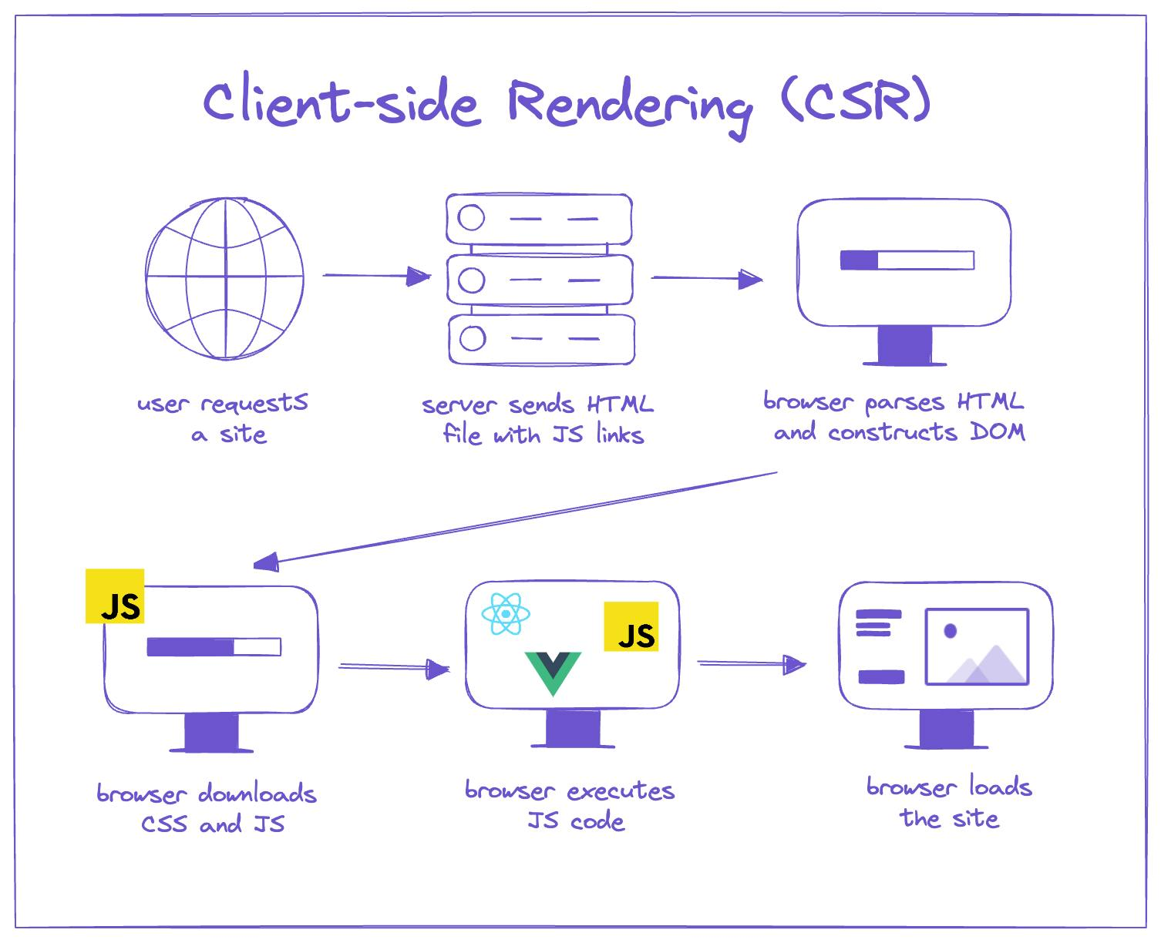

Slide 7
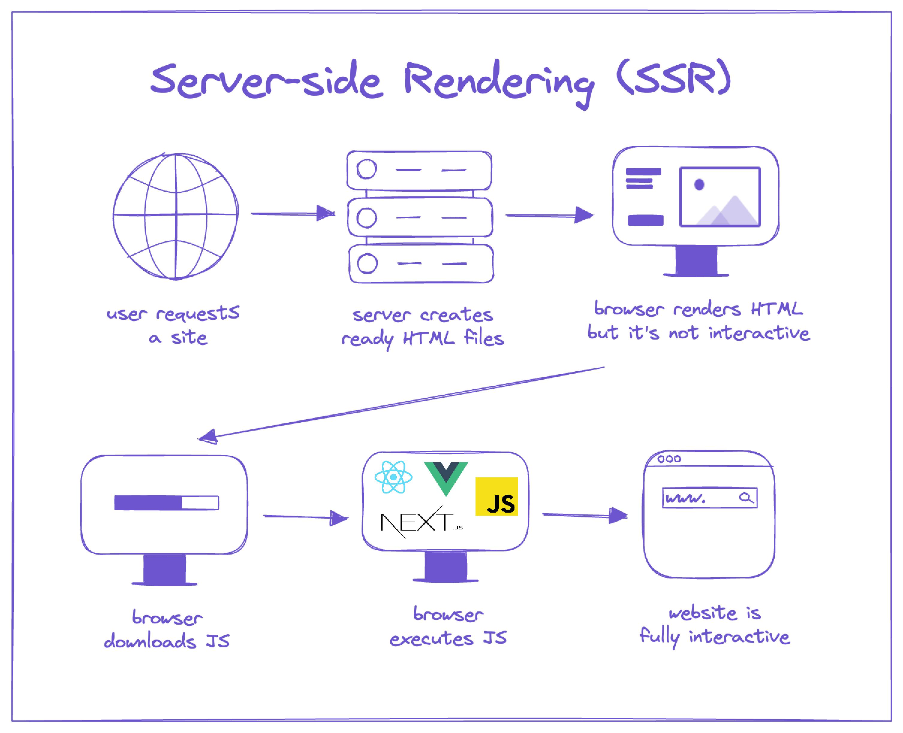

Slide 8
Static Rendering With static rendering, data fetching and rendering happens on the server at build time (when you deploy) or when revalidating data. Whenever a user visits your application, the cached result is served. There are a couple of benefits of static rendering: Faster Websites - Prerendered content can be cached and globally distributed when deployed to platforms like Vercel. This ensures that users around the world can access your website's content more quickly and reliably. Reduced Server Load - Because the content is cached, your server does not have to dynamically generate content for each user request. This can reduce compute costs. | Dynamic Rendering With dynamic rendering, content is rendered on the server for each user at request time (when the user visits the page). There are a couple of benefits of dynamic rendering: Real-Time Data - Dynamic rendering allows your application to display real-time or frequently updated data. This is ideal for applications where data changes often. User-Specific Content - It's easier to serve personalized content, such as dashboards or user profiles, and update the data based on user interaction. Request Time Information - Dynamic rendering allows you to access information that can only be known at request time, such as cookies or the URL search parameters.
Static rendering is useful for UI with no data or data that is shared across users, such as a static blog post or a product page. It might not be a good fit for a dashboard that has personalized data which is regularly updated.

Slide 9

01
Project Setup & Tech Stack

Slide 10
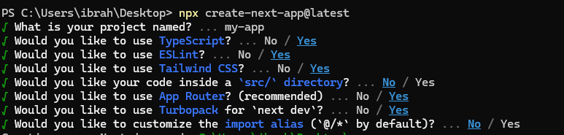
Installing Nextjs
1. npx create-next-app@latest
2.

Slide 11

NextJs Frontend

Slide 12
Client Side Rendering
Server Side Rendering
"use client";
import { useState } from 'react';
export default function Counter() {
const [count, setCount] = useState(0);
return (
<div>
<button onClick={() => setCount(count + 1)}>Count: {count}</button>
</div>
);
}
export default async function PostsPage() {
const res = await fetch("https://jsonplaceholder.typicode.com/posts");
const posts = await res.json();
return (
<div className="p-4">
<h1 className="text-xl font-bold mb-4">Server-Side Rendered Posts</h1>
<ul className="space-y-2">
{posts.slice(0, 5).map((post: any) => (
<li key={post.id} className="p-2 bg-gray-100 rounded">
<strong>{post.title}</strong>
<p>{post.body}</p>
</li>
))}
</ul>
</div>
);
}

Slide 13
Static Rendering is the default
Static Rendering
Dynamic Rendering
export const dynamic = 'force-static’; // optional
export default async function StaticPage() {
const res = await fetch("https://api.example.com/posts", {
cache: "force-cache", // or omit, as it's the default
});
const posts = await res.json();
return (
<div>
{posts.map((post) => (
<div key={post.id}>{post.title}</div>
))}
</div>
);
}
export const dynamic = 'force-dynamic';
export default async function DynamicPage() {
const res = await fetch("https://api.example.com/posts", { cache: 'no-store' });
const posts = await res.json();
return (
<div>
{posts.map(post => (
<h2 key={post.id}>{post.title}</h2>
))}
</div>
);
}

Slide 14
layout.tsx
// app/layout.tsx (default server component)
import "./globals.css";
import { ReactNode } from "react";
import { Inter } from "next/font/google"; const inter = Inter({ subsets: ["latin"] }); export const metadata = {
title: "My App",
description: "Modern Next.js App using App Router",
}; export default function RootLayout({ children }: { children: ReactNode }) {
return (
<html lang="en">
<body className={inter.className}>
<header className="p-4 bg-black text-white">My Header</header>
<main className="p-6">{children}</main>
<footer className="p-4 bg-gray-200 text-center">My Footer</footer>
</body>
</html>
);
}
Key Features:
Server Component by default
Wraps all routes inside its directory
Supports nested layouts
Can include:
HTML skeleton (div, main, nav, etc.)
<head> metadata
Persistent UI (navbar, sidebar, etc.)
Context Providers (if you mark it as "use client")

Slide 15
'use client' // Error boundaries must be Client Components
import { useEffect } from 'react'
export default function Error({
error,
reset,
}: {
error: Error & { digest?: string }
reset: () => void
}) {
useEffect(() => {
// Log the error to an error reporting service
console.error(error)
}, [error])
return (
<div>
<h2>Something went wrong!</h2>
<button
onClick={
// Attempt to recover by trying to re-render the segment
() => reset()
}
>
Try again
</button>
</div>
)
}
error.tsx
What kind of errors does it catch?
It catches JavaScript errors that happen during:
await fetch() in Server Components
Suspense fallbacks that fail
Client-side crashes
Server actions
It does not catch:
Build-time or syntax errors
Errors from console.error or warnings

Slide 16
loading.tsx
When is loading.tsx shown?
During initial navigation to the page
When navigating between routes via <Link> or router.push()
When a Server Component or Server Action is fetching or waiting
// app/dashboard/loading.tsx
export default function Loading() {
return (
<div className="p-6 text-gray-600 animate-pulse">
<p>Loading dashboard...</p>
</div>
);
}

Slide 17
not-found.tsx
Best Practices
Use notFound() in dynamic routes when data is missing or invalid
Provide custom UI in not-found.tsx that matches your site’s design
Don’t throw an error — use notFound() instead of throw new Error('404')
//app/not-found.tsx
export default function NotFound() {
return (
<div className="p-8 text-center">
<h1 className="text-3xl font-bold">404 - Page Not Found</h1>
<p className="mt-4">
Sorry, we couldn’t find the page you were looking for.
</p>
</div>
);
}
Bonus: Nested not-found.tsx
If you place not-found.tsx inside a subfolder, it only handles 404s in that segment. You can have:
A global 404 for /
A custom 404 for /dashboard
Another for /blog
Next.js will bubble up to the nearest not-found.tsx it can find in the route tree.

Slide 18
template.tsx
//app/dashboard/template.tsx
export default function DashboardTemplate({
children,
}: {
children: React.ReactNode;
}) {
console.log("DashboardTemplate rendered");
return (
<div className="p-4 border rounded shadow">
<h1 className="text-2xl font-bold">Dashboard (template)</h1>
{children}
</div>
);
}
Why use template.tsx?
Use template.tsx when you want:
Animations or transitions between route segments
Fresh state on every navigation
A layout that should not be cached or preserved across navigations
Components like modals, forms, or wizards that need to reset on every entry

Slide 19
Lazy Import
Why Lazy-Import?
Faster First Paint Only the code needed for the initial view is sent to the browser. Large or rarely-used components (charts, map libraries, admin UIs) wait until you actually navigate or interact.
Bandwidth Savings Users on slow connections don’t download chunks they’ll never see.
Better Perceived Performance Showing a lightweight “Loading…” shell keeps things snappy, even if the full feature is hefty.

Slide 20
Lazy Import (Nextjs)
'use client’ //only because of ssr: false
import { useState } from 'react'
import dynamic from 'next/dynamic'
// Client Components:
const ComponentA = dynamic(() => import('../components/A'))
const ComponentB = dynamic(() => import('../components/B'))
const ComponentC = dynamic(() => import('../components/C'), { ssr: false })
export default function ClientComponentExample() {
const [showMore, setShowMore] = useState(false)
return (
<div>
{/* Load immediately, but in a separate client bundle */}
<ComponentA />
{/* Load on demand, only when/if the condition is met */}
{showMore && <ComponentB />}
<button onClick={() => setShowMore(!showMore)}>Toggle</button>
{/* Load only on the client side */}
<ComponentC />
</div>
)
}

Slide 21
Lazy Import(reactjs)
"use client";
import { lazy, Suspense } from 'react';
const HeavyChart = lazy(() => import('../components/HeavyChart'));
export default function Dashboard() {
return (
<div>
<h1>Analytics</h1>
<Suspense fallback={<p>Loading chart…</p>}>
<HeavyChart />
</Suspense>
</div>
);
}

Slide 22
Revalidate Path
What is revalidatePath()?
A built-in Next.js function to invalidate cached routes
Forces Next.js to re-render a path on the next request
Why Do We Need It?
Pages and fetch() are cached by default
After mutating data (e.g., creating a post), UI shows stale data
revalidatePath() ensures updated content is visible

Slide 23
Revalidate Path
Periodic
Manual
// Page component
export default async function Home() {
const res = await fetch("http://localhost:3000/api/posts", {
next: { revalidate: 60 }, // 🔁 cached
});
const posts = await res.json(); return (
<main>
<h1>Posts</h1>
<form action={createPost}>
<input type="text" name="title" placeholder="Post title" required />
<button type="submit">Add Post</button>
</form> <ul>
{posts.map((post: any) => (
<li key={post.id}>{post.title}</li>
))}
</ul>
</main>
);
}
// app/page.tsx
import { revalidatePath } from "next/cache";
// Server action to create a post
export async function createPost(formData: FormData) {
"use server";
const title = formData.get("title") as string;
await fetch("http://localhost:3000/api/posts", {
method: "POST",
body: JSON.stringify({ title }),
headers: { "Content-Type": "application/json" },
});
// ✅ This is the key line
revalidatePath("/");
}

Slide 24
Thank you!
Thank You!

